Slide 1

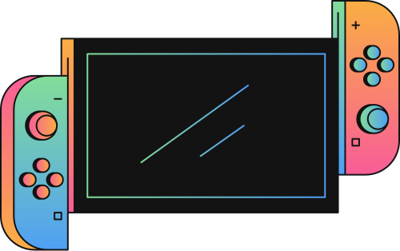
GAMIFIED LEARNING PROGRESS TRACKER
START
TURNING LEARNING INTO AN EXCITING ADVENTURE
1

Slide 2
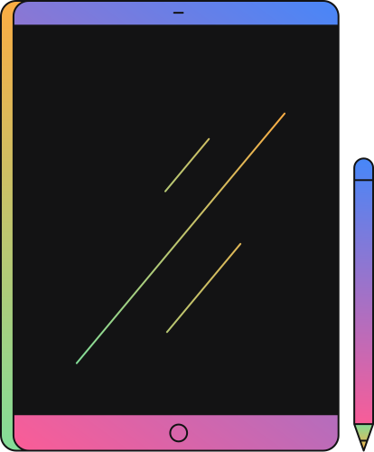
PRESENTERS
BIBEK KAPALI
&
BIJAY KOIRALA
2

Slide 3

QUEST MAP
INTRODUCTION
5. REQUIREMENT IDENTIFICATION
2. PROBLEM STATEMENT
6. FEASIBILITY STUDY
3. OBJECTIVES
7. HLD
4. METHODOLOGY
8. GANTT CHART
9. POSSIBLE OUTCOMES
3

Slide 4
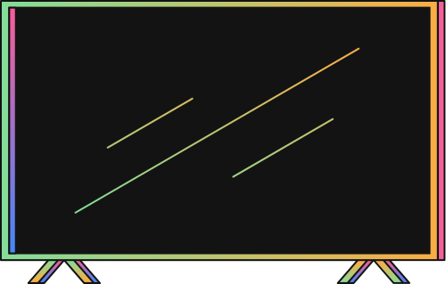


INTRODUCTION
Combination of
Learning process
Gaming Ui/Ux
Discord badges style
4
Notes:
Gamified learning progress tracker is a combination of :
Gaming ui/ux : Leaderboards, trophies, badges, rewards
Discord Badges: Give out badges, like Discord does, for achieving something.
Psychology hacks : A child normal attracted to that place where s/he get rewards

Slide 5
PROBLEM STATEMENT
Problem seen in old system:
Boring ui/ux design of existing system and one sided report are the reasons to build this new system.
5

Slide 6
OBJECTIVE OF THIS SYSTEM
To show learning progress in graphs and charts.
To help teachers understand each student struggle.
To keep parents informed about their child’s learning journey.
To make learning fun with points and badges.
6

Slide 7
METHODOLOGY
Proper study or analysis of all the methods used in the research.
Explains the research design and methods we'll use to complete our research.
7

Slide 8
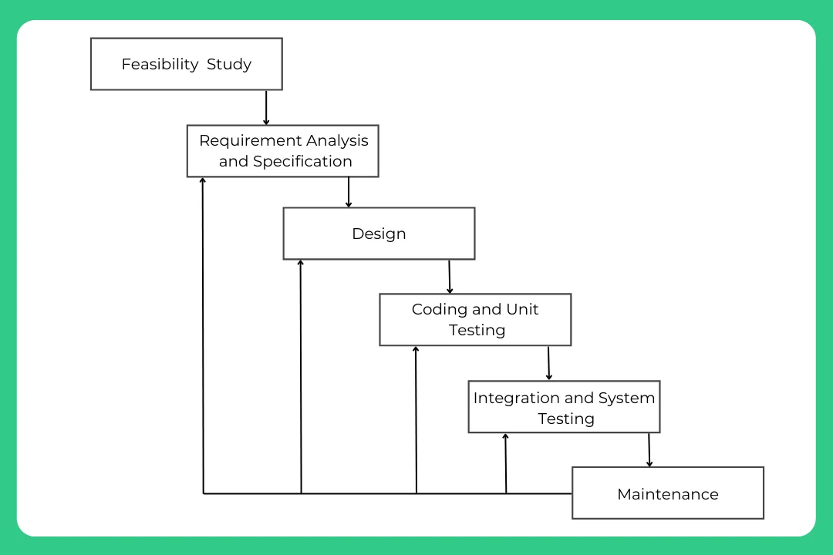
ITERATIVE WATERFALL METHODOLOGY
8
Notes:
Iterative waterfall is a way of making software where we do things step by step, but we can go back and fix stuff or make changes before moving forward again.
It's used because it's straightforward, easy to understand, allows for adjustments and improvements to be made throughout the development process, making it flexible and adaptable.

Slide 9
REQUIREMENT IDENTIFICATION
Study of the existing system: checking out what others have
Document review
Reading articles
2. Requirement collection : Process of collecting information required for a proper system.
Observation
Discussed with friends and teachers
Online group chat and articles
9
Notes:
1. Study of the existing system : checking what others system look like, what other system have
We do : document review , reading articles of the different system so that then we were able to find out what other system actually have.
2.After know what others have we try to find out our own system requirement. Requirements can be functional and functional.
We observe, do discussion with friends and teachers. Also we found some answer to our searched queries in internet group chat and articles.

Slide 10
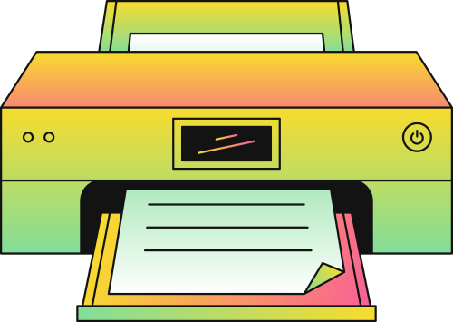
FEASIBILITY STUDY
INSTRUCTION
ANSWER
A feasibility study is like process of analyzing if an idea makes sense and is do-able or not before diving into it.
10

Slide 11
TYPES OF FEASIBILITY STUDY
There are mainly 3 types of feasibility :
1. TECHNICAL FEASIBILITY
2. OPERATIONAL FEASIBILITY
3. ECONOMICAL FEASIBILITY
The system is easy to use, doesn't disrupt our work, and is easy to maintain.
That's why it's operationally feasible.
It offers more benefits than what we invest in it. It saves time and resources, and it will have long-term benefits.
That’s why this system is economically feasible.
We can build it using HTML, CSS, JavaScript, PHP, MySQL, and VS Code.
Thats why this system is technically feasible.
11
Notes:
1. Technical Feasibility: This is about whether the technology needed for a project is available or can be developed within the constraints of time and budget.
For example, Can the technology needed for your gamified learning progress tracker be developed or is it already available? Think about things like the programming languages, databases, and platforms you'll need. Make sure they're within your reach in terms of skills and resources.
2. Economic Feasibility: This is all about whether a project makes financial sense. It involves assessing the costs versus the benefits.
Example question like : Will creating this tracker be cost-effective? Consider expenses like software development tools, hosting services, and any other resources you might need. Also, think about potential revenue streams or cost savings your tracker could generate in the long run.
3. Operational Feasibility: This focuses on whether the proposed project fits with the organization's operations and goals. It considers factors like how the project will be managed, whether there are enough resources available, and if the project aligns with the organization's values and objectives.
Example question: Is your tracker compatible with how users learn and progress? Think about factors like user interface design, ease of use, and integration with existing learning systems. Also, consider how you'll manage and maintain the tracker once it's up and running.

Slide 12
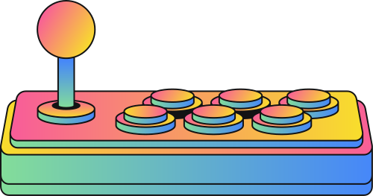
HIGH LEVEL DESIGN
It is like detailed map which provides the overall idea of how different parts of the system will work together .
12
Notes:
High-Level Design (HLD):
High-level design is like drawing a blueprint for our project. It's a broad overview that outlines the structure and major components of our system without getting into the nitty-gritty details. Think of it as the big picture view.
HLDD (high level design document) : A high-level design document is a formal document that describes the architecture and design of our project at a high level.

Slide 13
HIGH LEVEL DESIGN
Different types of diagrams used to illustrate various aspect of the system design :
Flow chart
Use case Diagram
DFD
ER Diagram
13
Notes:
In the context of a High-Level Design (HLD), these are all different types of diagrams or models used to illustrate various aspects of the system design:
Flowchart:
A flowchart is a diagram that represents the flow of control or data in a system. It uses different shapes and arrows to depict the sequence of steps or processes.
In an HLD, flowcharts might be used to illustrate high-level processes or workflows within the system, such as user interactions or the flow of data between major components.
Entity-Relationship (ER) Diagram:
An ER diagram is a visual representation of the data model for a system. It shows the entities (such as objects, concepts, or events) within the system and the relationships between them.
In an HLD, an ER diagram might be used to outline the major entities and their relationships in the system, helping to define the overall data structure.
Data Flow Diagram (DFD):
A DFD is a graphical representation of how data flows through a system. It shows the processes that transform input data into output data, as well as the data stores and external entities involved.
In an HLD, DFDs can be used to depict the high-level flow of data between major components or subsystems in the system, providing a conceptual view of how information moves through the system.
Use Case Diagram:
A use case diagram illustrates the interactions between users (actors) and a system, showing the various ways in which users can interact with the system to achieve specific goals (use cases).
In an HLD, a use case diagram might be used to identify the primary actors interacting with the system and the high-level use cases they perform, helping to define the system's functional requirements from a user's perspective.
These diagrams are all valuable tools for communicating and visualizing different aspects of the system design during the high-level design phase, helping stakeholders understand the system's architecture, data model, data flow, and user interactions.

Slide 14
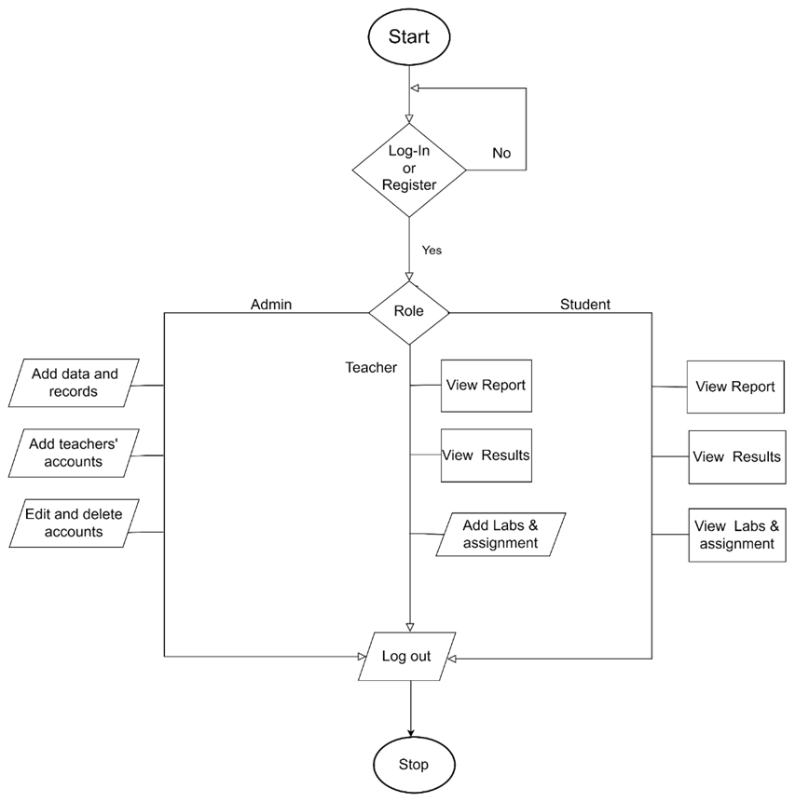
SYSTEM FLOW CHART
14
Notes:
In the context of a High-Level Design (HLD), these are all different types of diagrams or models used to illustrate various aspects of the system design:
Flowchart:
A flowchart is a diagram that represents the flow of control or data in a system. It uses different shapes and arrows to depict the sequence of steps or processes.
In an HLD, flowcharts might be used to illustrate high-level processes or workflows within the system, such as user interactions or the flow of data between major components.
Entity-Relationship (ER) Diagram:
An ER diagram is a visual representation of the data model for a system. It shows the entities (such as objects, concepts, or events) within the system and the relationships between them.
In an HLD, an ER diagram might be used to outline the major entities and their relationships in the system, helping to define the overall data structure.
Data Flow Diagram (DFD):
A DFD is a graphical representation of how data flows through a system. It shows the processes that transform input data into output data, as well as the data stores and external entities involved.
In an HLD, DFDs can be used to depict the high-level flow of data between major components or subsystems in the system, providing a conceptual view of how information moves through the system.
Use Case Diagram:
A use case diagram illustrates the interactions between users (actors) and a system, showing the various ways in which users can interact with the system to achieve specific goals (use cases).
In an HLD, a use case diagram might be used to identify the primary actors interacting with the system and the high-level use cases they perform, helping to define the system's functional requirements from a user's perspective.
These diagrams are all valuable tools for communicating and visualizing different aspects of the system design during the high-level design phase, helping stakeholders understand the system's architecture, data model, data flow, and user interactions.

Slide 15
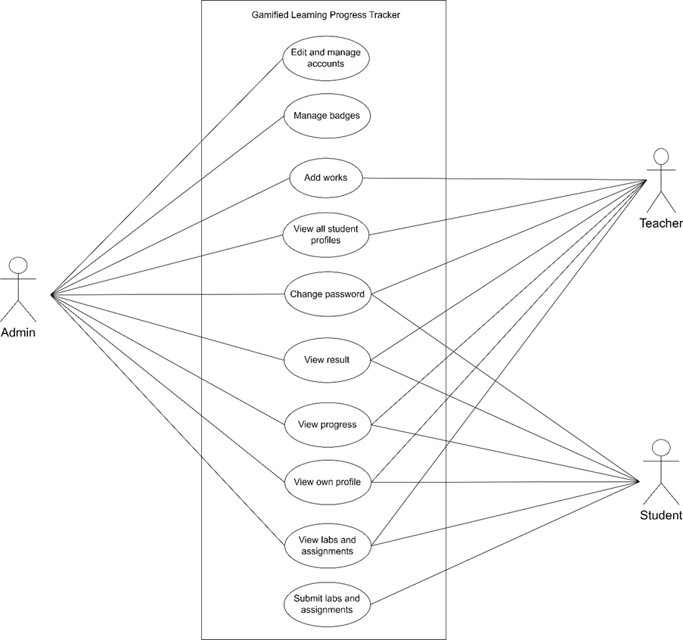
USE CASE DIAGRAM
15
Notes:
In the context of a High-Level Design (HLD), these are all different types of diagrams or models used to illustrate various aspects of the system design:
Flowchart:
A flowchart is a diagram that represents the flow of control or data in a system. It uses different shapes and arrows to depict the sequence of steps or processes.
In an HLD, flowcharts might be used to illustrate high-level processes or workflows within the system, such as user interactions or the flow of data between major components.
Entity-Relationship (ER) Diagram:
An ER diagram is a visual representation of the data model for a system. It shows the entities (such as objects, concepts, or events) within the system and the relationships between them.
In an HLD, an ER diagram might be used to outline the major entities and their relationships in the system, helping to define the overall data structure.
Data Flow Diagram (DFD):
A DFD is a graphical representation of how data flows through a system. It shows the processes that transform input data into output data, as well as the data stores and external entities involved.
In an HLD, DFDs can be used to depict the high-level flow of data between major components or subsystems in the system, providing a conceptual view of how information moves through the system.
Use Case Diagram:
A use case diagram illustrates the interactions between users (actors) and a system, showing the various ways in which users can interact with the system to achieve specific goals (use cases).
In an HLD, a use case diagram might be used to identify the primary actors interacting with the system and the high-level use cases they perform, helping to define the system's functional requirements from a user's perspective.
These diagrams are all valuable tools for communicating and visualizing different aspects of the system design during the high-level design phase, helping stakeholders understand the system's architecture, data model, data flow, and user interactions.

Slide 16
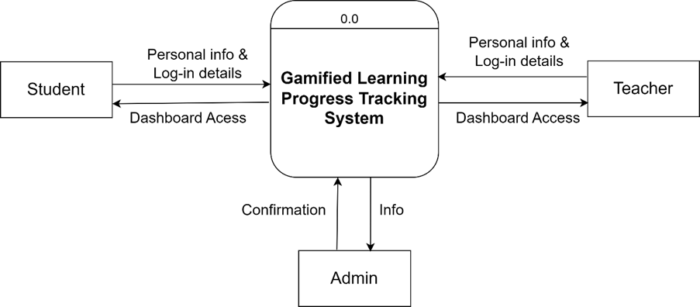
DFD LEVEL 0
16
Notes:
In the context of a High-Level Design (HLD), these are all different types of diagrams or models used to illustrate various aspects of the system design:
Flowchart:
A flowchart is a diagram that represents the flow of control or data in a system. It uses different shapes and arrows to depict the sequence of steps or processes.
In an HLD, flowcharts might be used to illustrate high-level processes or workflows within the system, such as user interactions or the flow of data between major components.
Entity-Relationship (ER) Diagram:
An ER diagram is a visual representation of the data model for a system. It shows the entities (such as objects, concepts, or events) within the system and the relationships between them.
In an HLD, an ER diagram might be used to outline the major entities and their relationships in the system, helping to define the overall data structure.
Data Flow Diagram (DFD):
A DFD is a graphical representation of how data flows through a system. It shows the processes that transform input data into output data, as well as the data stores and external entities involved.
In an HLD, DFDs can be used to depict the high-level flow of data between major components or subsystems in the system, providing a conceptual view of how information moves through the system.
Use Case Diagram:
A use case diagram illustrates the interactions between users (actors) and a system, showing the various ways in which users can interact with the system to achieve specific goals (use cases).
In an HLD, a use case diagram might be used to identify the primary actors interacting with the system and the high-level use cases they perform, helping to define the system's functional requirements from a user's perspective.
These diagrams are all valuable tools for communicating and visualizing different aspects of the system design during the high-level design phase, helping stakeholders understand the system's architecture, data model, data flow, and user interactions.

Slide 17
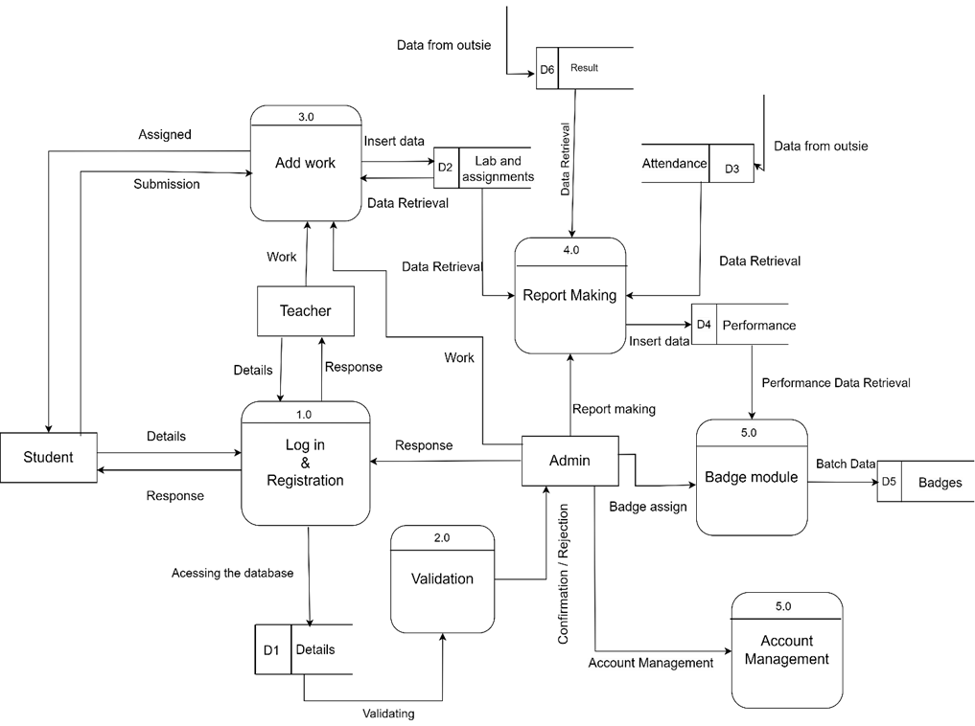
DFD LEVEL 1
17
Notes:
In the context of a High-Level Design (HLD), these are all different types of diagrams or models used to illustrate various aspects of the system design:
Flowchart:
A flowchart is a diagram that represents the flow of control or data in a system. It uses different shapes and arrows to depict the sequence of steps or processes.
In an HLD, flowcharts might be used to illustrate high-level processes or workflows within the system, such as user interactions or the flow of data between major components.
Entity-Relationship (ER) Diagram:
An ER diagram is a visual representation of the data model for a system. It shows the entities (such as objects, concepts, or events) within the system and the relationships between them.
In an HLD, an ER diagram might be used to outline the major entities and their relationships in the system, helping to define the overall data structure.
Data Flow Diagram (DFD):
A DFD is a graphical representation of how data flows through a system. It shows the processes that transform input data into output data, as well as the data stores and external entities involved.
In an HLD, DFDs can be used to depict the high-level flow of data between major components or subsystems in the system, providing a conceptual view of how information moves through the system.
Use Case Diagram:
A use case diagram illustrates the interactions between users (actors) and a system, showing the various ways in which users can interact with the system to achieve specific goals (use cases).
In an HLD, a use case diagram might be used to identify the primary actors interacting with the system and the high-level use cases they perform, helping to define the system's functional requirements from a user's perspective.
These diagrams are all valuable tools for communicating and visualizing different aspects of the system design during the high-level design phase, helping stakeholders understand the system's architecture, data model, data flow, and user interactions.

Slide 18
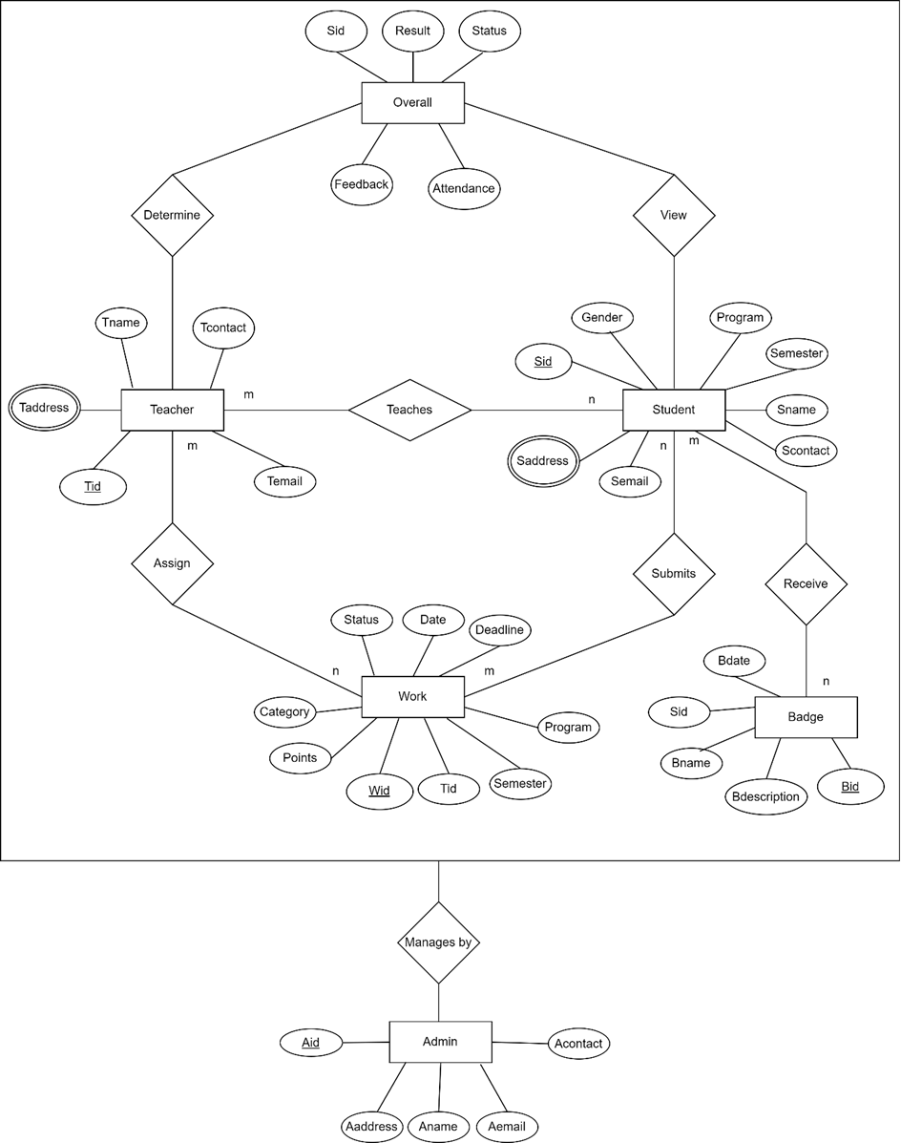
ER
18
Notes:
In the context of a High-Level Design (HLD), these are all different types of diagrams or models used to illustrate various aspects of the system design:
Flowchart:
A flowchart is a diagram that represents the flow of control or data in a system. It uses different shapes and arrows to depict the sequence of steps or processes.
In an HLD, flowcharts might be used to illustrate high-level processes or workflows within the system, such as user interactions or the flow of data between major components.
Entity-Relationship (ER) Diagram:
An ER diagram is a visual representation of the data model for a system. It shows the entities (such as objects, concepts, or events) within the system and the relationships between them.
In an HLD, an ER diagram might be used to outline the major entities and their relationships in the system, helping to define the overall data structure.
Data Flow Diagram (DFD):
A DFD is a graphical representation of how data flows through a system. It shows the processes that transform input data into output data, as well as the data stores and external entities involved.
In an HLD, DFDs can be used to depict the high-level flow of data between major components or subsystems in the system, providing a conceptual view of how information moves through the system.
Use Case Diagram:
A use case diagram illustrates the interactions between users (actors) and a system, showing the various ways in which users can interact with the system to achieve specific goals (use cases).
In an HLD, a use case diagram might be used to identify the primary actors interacting with the system and the high-level use cases they perform, helping to define the system's functional requirements from a user's perspective.
These diagrams are all valuable tools for communicating and visualizing different aspects of the system design during the high-level design phase, helping stakeholders understand the system's architecture, data model, data flow, and user interactions.

Slide 19
GANTT CHART
A gantt chart is a horizontal bar chart used in project management to visually represent a project with plain over time
19

Slide 20
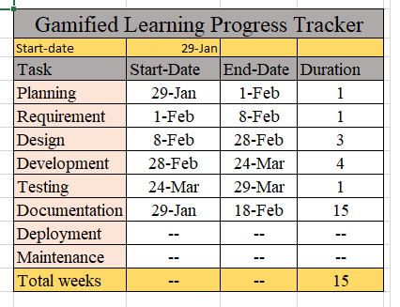
ACITVITY TABLE
20
Notes:
In the context of a High-Level Design (HLD), these are all different types of diagrams or models used to illustrate various aspects of the system design:
Flowchart:
A flowchart is a diagram that represents the flow of control or data in a system. It uses different shapes and arrows to depict the sequence of steps or processes.
In an HLD, flowcharts might be used to illustrate high-level processes or workflows within the system, such as user interactions or the flow of data between major components.
Entity-Relationship (ER) Diagram:
An ER diagram is a visual representation of the data model for a system. It shows the entities (such as objects, concepts, or events) within the system and the relationships between them.
In an HLD, an ER diagram might be used to outline the major entities and their relationships in the system, helping to define the overall data structure.
Data Flow Diagram (DFD):
A DFD is a graphical representation of how data flows through a system. It shows the processes that transform input data into output data, as well as the data stores and external entities involved.
In an HLD, DFDs can be used to depict the high-level flow of data between major components or subsystems in the system, providing a conceptual view of how information moves through the system.
Use Case Diagram:
A use case diagram illustrates the interactions between users (actors) and a system, showing the various ways in which users can interact with the system to achieve specific goals (use cases).
In an HLD, a use case diagram might be used to identify the primary actors interacting with the system and the high-level use cases they perform, helping to define the system's functional requirements from a user's perspective.
These diagrams are all valuable tools for communicating and visualizing different aspects of the system design during the high-level design phase, helping stakeholders understand the system's architecture, data model, data flow, and user interactions.

Slide 21
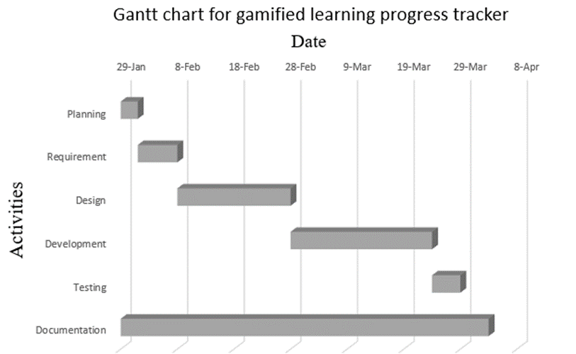
GANTT CHART
21
Notes:
In the context of a High-Level Design (HLD), these are all different types of diagrams or models used to illustrate various aspects of the system design:
Flowchart:
A flowchart is a diagram that represents the flow of control or data in a system. It uses different shapes and arrows to depict the sequence of steps or processes.
In an HLD, flowcharts might be used to illustrate high-level processes or workflows within the system, such as user interactions or the flow of data between major components.
Entity-Relationship (ER) Diagram:
An ER diagram is a visual representation of the data model for a system. It shows the entities (such as objects, concepts, or events) within the system and the relationships between them.
In an HLD, an ER diagram might be used to outline the major entities and their relationships in the system, helping to define the overall data structure.
Data Flow Diagram (DFD):
A DFD is a graphical representation of how data flows through a system. It shows the processes that transform input data into output data, as well as the data stores and external entities involved.
In an HLD, DFDs can be used to depict the high-level flow of data between major components or subsystems in the system, providing a conceptual view of how information moves through the system.
Use Case Diagram:
A use case diagram illustrates the interactions between users (actors) and a system, showing the various ways in which users can interact with the system to achieve specific goals (use cases).
In an HLD, a use case diagram might be used to identify the primary actors interacting with the system and the high-level use cases they perform, helping to define the system's functional requirements from a user's perspective.
These diagrams are all valuable tools for communicating and visualizing different aspects of the system design during the high-level design phase, helping stakeholders understand the system's architecture, data model, data flow, and user interactions.

Slide 22
EXPRECTATION OUTCOMES
A functional web app
Clean ui
Badge system
22

Slide 23
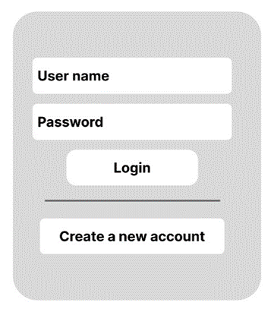
USER LOGIN
23
Notes:
In the context of a High-Level Design (HLD), these are all different types of diagrams or models used to illustrate various aspects of the system design:
Flowchart:
A flowchart is a diagram that represents the flow of control or data in a system. It uses different shapes and arrows to depict the sequence of steps or processes.
In an HLD, flowcharts might be used to illustrate high-level processes or workflows within the system, such as user interactions or the flow of data between major components.
Entity-Relationship (ER) Diagram:
An ER diagram is a visual representation of the data model for a system. It shows the entities (such as objects, concepts, or events) within the system and the relationships between them.
In an HLD, an ER diagram might be used to outline the major entities and their relationships in the system, helping to define the overall data structure.
Data Flow Diagram (DFD):
A DFD is a graphical representation of how data flows through a system. It shows the processes that transform input data into output data, as well as the data stores and external entities involved.
In an HLD, DFDs can be used to depict the high-level flow of data between major components or subsystems in the system, providing a conceptual view of how information moves through the system.
Use Case Diagram:
A use case diagram illustrates the interactions between users (actors) and a system, showing the various ways in which users can interact with the system to achieve specific goals (use cases).
In an HLD, a use case diagram might be used to identify the primary actors interacting with the system and the high-level use cases they perform, helping to define the system's functional requirements from a user's perspective.
These diagrams are all valuable tools for communicating and visualizing different aspects of the system design during the high-level design phase, helping stakeholders understand the system's architecture, data model, data flow, and user interactions.

Slide 24
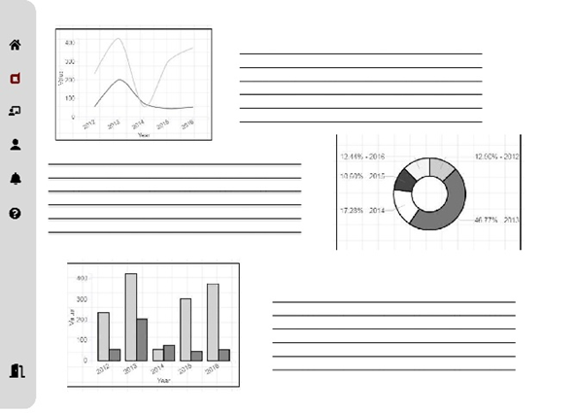
USER DASHBOARD
24
Notes:
In the context of a High-Level Design (HLD), these are all different types of diagrams or models used to illustrate various aspects of the system design:
Flowchart:
A flowchart is a diagram that represents the flow of control or data in a system. It uses different shapes and arrows to depict the sequence of steps or processes.
In an HLD, flowcharts might be used to illustrate high-level processes or workflows within the system, such as user interactions or the flow of data between major components.
Entity-Relationship (ER) Diagram:
An ER diagram is a visual representation of the data model for a system. It shows the entities (such as objects, concepts, or events) within the system and the relationships between them.
In an HLD, an ER diagram might be used to outline the major entities and their relationships in the system, helping to define the overall data structure.
Data Flow Diagram (DFD):
A DFD is a graphical representation of how data flows through a system. It shows the processes that transform input data into output data, as well as the data stores and external entities involved.
In an HLD, DFDs can be used to depict the high-level flow of data between major components or subsystems in the system, providing a conceptual view of how information moves through the system.
Use Case Diagram:
A use case diagram illustrates the interactions between users (actors) and a system, showing the various ways in which users can interact with the system to achieve specific goals (use cases).
In an HLD, a use case diagram might be used to identify the primary actors interacting with the system and the high-level use cases they perform, helping to define the system's functional requirements from a user's perspective.
These diagrams are all valuable tools for communicating and visualizing different aspects of the system design during the high-level design phase, helping stakeholders understand the system's architecture, data model, data flow, and user interactions.

Slide 25
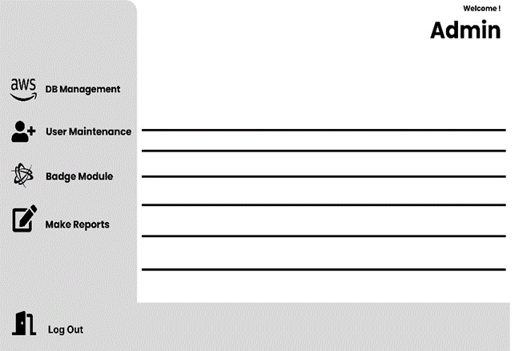
ADMIN DASHBOARD
25
Notes:
In the context of a High-Level Design (HLD), these are all different types of diagrams or models used to illustrate various aspects of the system design:
Flowchart:
A flowchart is a diagram that represents the flow of control or data in a system. It uses different shapes and arrows to depict the sequence of steps or processes.
In an HLD, flowcharts might be used to illustrate high-level processes or workflows within the system, such as user interactions or the flow of data between major components.
Entity-Relationship (ER) Diagram:
An ER diagram is a visual representation of the data model for a system. It shows the entities (such as objects, concepts, or events) within the system and the relationships between them.
In an HLD, an ER diagram might be used to outline the major entities and their relationships in the system, helping to define the overall data structure.
Data Flow Diagram (DFD):
A DFD is a graphical representation of how data flows through a system. It shows the processes that transform input data into output data, as well as the data stores and external entities involved.
In an HLD, DFDs can be used to depict the high-level flow of data between major components or subsystems in the system, providing a conceptual view of how information moves through the system.
Use Case Diagram:
A use case diagram illustrates the interactions between users (actors) and a system, showing the various ways in which users can interact with the system to achieve specific goals (use cases).
In an HLD, a use case diagram might be used to identify the primary actors interacting with the system and the high-level use cases they perform, helping to define the system's functional requirements from a user's perspective.
These diagrams are all valuable tools for communicating and visualizing different aspects of the system design during the high-level design phase, helping stakeholders understand the system's architecture, data model, data flow, and user interactions.

Slide 26
FEEDBACK
Any question?
26

Slide 27

THANKS FOR PLAYING!
END
27

